Slide 1
SAP CPI Exception Handling

Slide 2
Table of Contents
Exception Handling
1
Modelling of Exception Handling
2
Exception Handling Testing
3
4
Exception Message to Email

Slide 3
1. Exception Handling
What is Exception handling
Exception handling is the process of responding to the occurrence, during message processing, of exceptions. There exists scenarios where you want to control the exception process.
For example, during a message processing you want to log all the exceptions in a specific location or server; or you want to modify the exception message sent back to the receiver; and so on.
An exception is handled by saving the current state of execution in a predefined place and switching the execution to a specific subroutine known as an exception sub-process.
Exceptions can occur during any of the message processing step – Mapping execution error, Content Routing error, and so on.

Slide 4
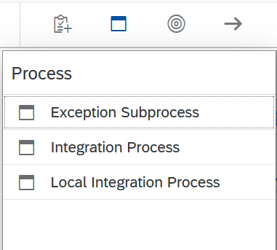
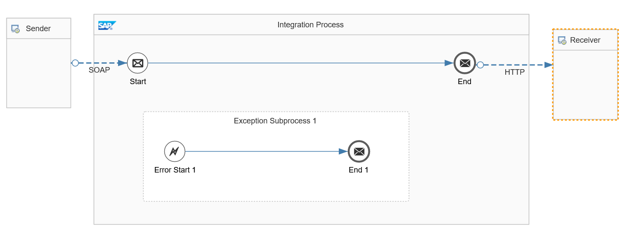
2. Modelling of Exception Handling
How to create Exception Handling in Iflow.
You model exceptions as a sub-process in the integration flows.
To add an exception sub-process to the integration flow, choose Exception Sub process from the palette.
And drop the sub-process into the integration process.
In the Integration flow below, when any exception occurs in the message processing – the sub-process is executed.
Note: The sub-process should not be connected to any of the elements of the integration flow

Slide 5
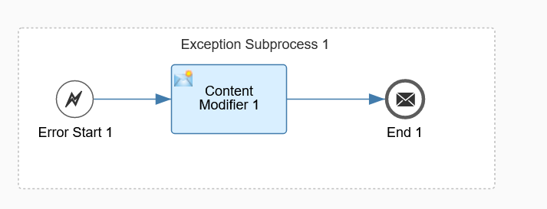
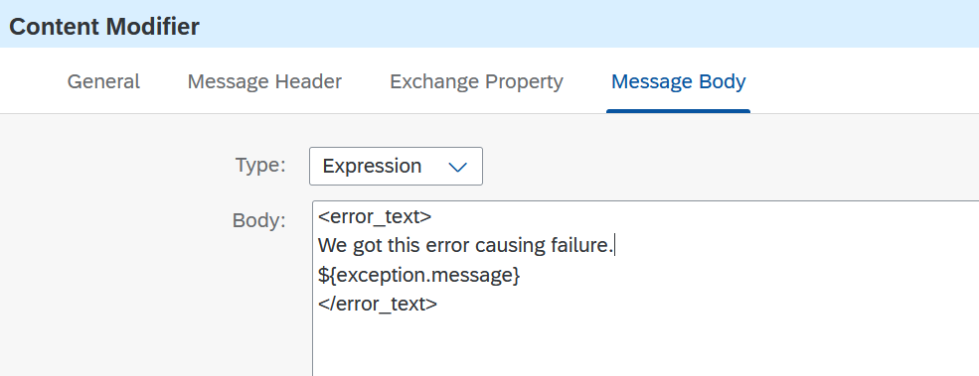
2. Modelling of Exception Handling
Working of Exception Handling in Iflow.
Consider the integration flow that we just saw: A SOAP sender sends messages to the integration flow (It is designed to fail at the mapping!) .
When an exception occurs in the message processing – the sub-process is called. In the sub-process, we modify the details of the fault message.
In Content modifier we can catch the exception if the
message processing is failed.

Slide 6
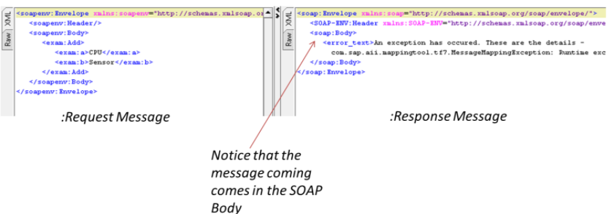

3. Exception Handling Testing
Observe the following.
We have included the following tag ${exception.message} in the Content Modifier step.
We have used Message End in the exception sub-process.
When I send a message from SOAP UI we get following error
in response.
The response come in the soap body.

Slide 7
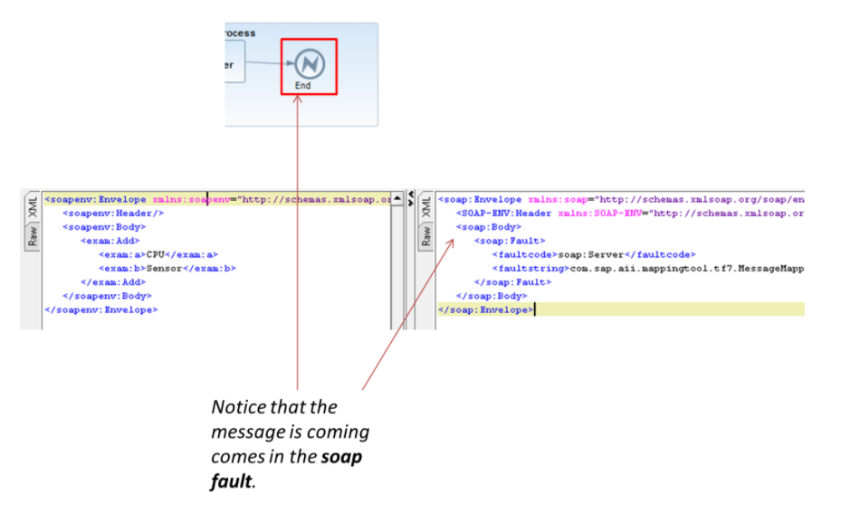
3. Exception Handling Testing
Observe the following.
You will get more details on exception using ${exception.message} or ${exception.stacktrace} elements.
If we change the End Message to an Error End, the response structure will change.
The exception shall go as part of the SOAP fault message.

Slide 8
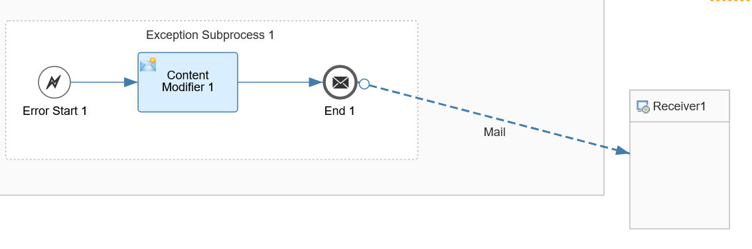
4. Exception Message to Email
Message to Email
you can choose to send the exception message to another endpoint.
Example – the sample integration flow we just saw has been modified to send the exceptions to an Email or SFTP locations.

Slide 9



